Slide 1
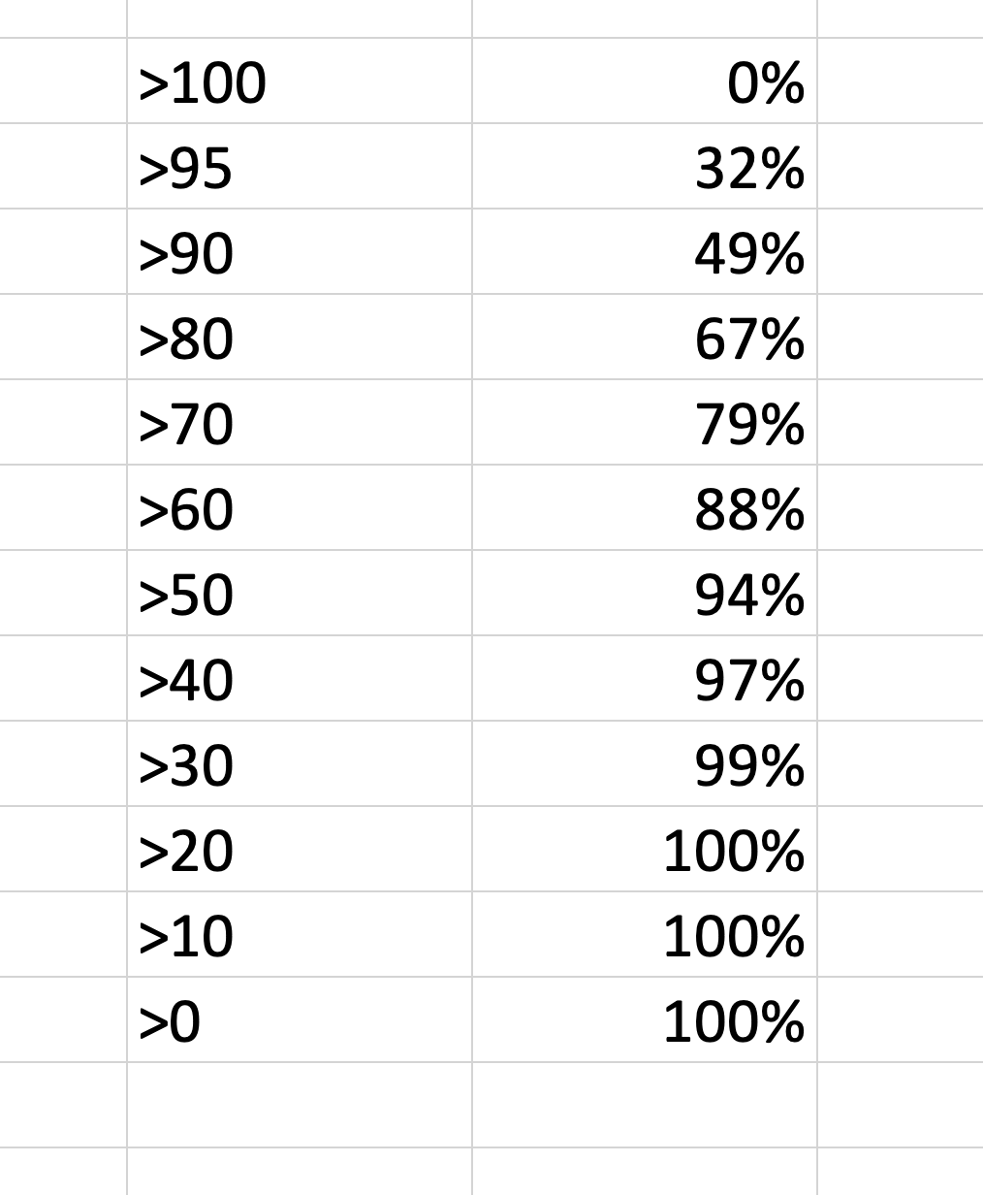
Perspective on midterm stats
Course deliberately starts slowly
We want everyone to master fundamentals
percent of class above grade

Slide 2
Looking forward
The course picks up in pace and difficulty from here
No big problems if you have learned the material to date
This week is easy because we know how to design recursive functions
Next week is a bit easier too
Then things really pick up
m08 abstraction
m09 genrec and search
m10 accumulators
m11 graphs
Makeup Monday means this is a slow week in 110 – USE THAT TIME!
Again, no big problems if you have learned the material to date

Slide 3
ANSWER NOW… For problem set 4…
which quadrant most closely matches your experience?
redid the whole HtDW process and maybe even marked up printed copy of starter
A
B
finished, with good score, in less than
6 hours
took more than 6 hours, or could not finish
C
D
jumped right into the code, editing what needed to add/ change

Slide 4
In list of <number>:<password> lookup password
3:ilk 7:ruf 42:ily 1:abc 50:dug 10:why 27:wit 14:olp 4:dcj …
How long does it take if list has length n ?

Slide 5
In list of <number>:<password> lookup password
3:ilk 7:ruf 42:ily 1:abc 50:dug 10:why 27:wit 14:olp 4:dcj …
How long does it take if list has length n ?
What about in this list?
1:abc 3:ilk 4:dcj 7:ruf 10:why 14:olp 27:wit 42:ily 50:dug

Slide 6
[from Wikipedia, edited]

Slide 7
10:why
3:ilk
42:ily
1:abc
4:dcj
27:wit
50:dug
7:ruf
14:olp

Slide 8
compound key, value, left, right
arb-sized
10:why
3:ilk
42:ily
1:abc
4:dcj
27:wit
50:dug
7:ruf
14:olp

Slide 9
(@htdd BST)
(define-struct node (key val l r))
;; A BST (Binary Search Tree) is one of:
;; - false
;; - (make-node Integer String BST BST)
;; interp. false means empty BST
;; key is the node key
;; val is the node val
;; l and r are left and right subtrees
;; CONSTRAINT: (INVARIANT) for a given node:
;; key is > all keys in its l(eft) child
;; key is < all keys in its r(ight) child
;; the same key never appears twice in the tree

Slide 10
(@htdd BST)
(define-struct node (key val l r))
;; A BST (Binary Search Tree) is one of:
;; - false
;; - (make-node Integer String BST BST)
;; interp. false means empty BST
;; key is the node key
;; val is the node val
;; l and r are left and right subtrees
;; CONSTRAINT: (INVARIANT) for a given node:
;; key is > all keys in its l(eft) child
;; key is < all keys in its r(ight) child
;; the same key never appears twice in the tree
(define (fn-for-bst t)
(cond [(false? t) (...)]
[else
(... (node-key t)
(node-val t)
(fn-for-bst (node-l t))
(fn-for-bst (node-r t)))]))

Slide 11
10:why
3:ilk
42:ily
1:abc
4:dcj
27:wit
50:dug
7:ruf
14:olp

Slide 12
LINES MAKE IT MUCH HARDER!
We are NOT doing lines!

